Slide 1










Mayank Kumar

Slide 2



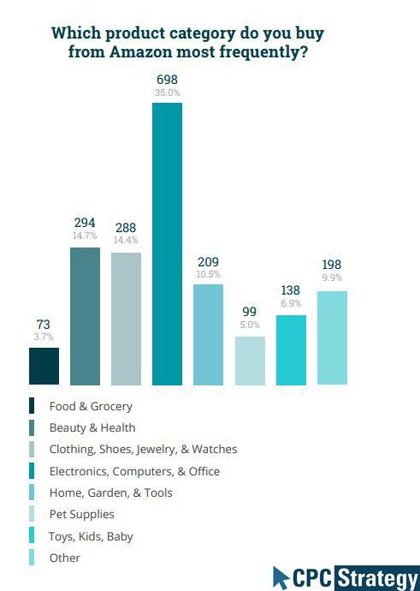
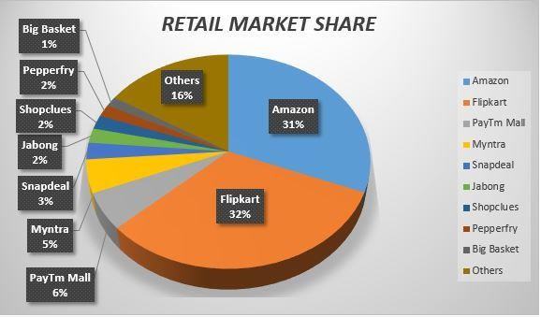
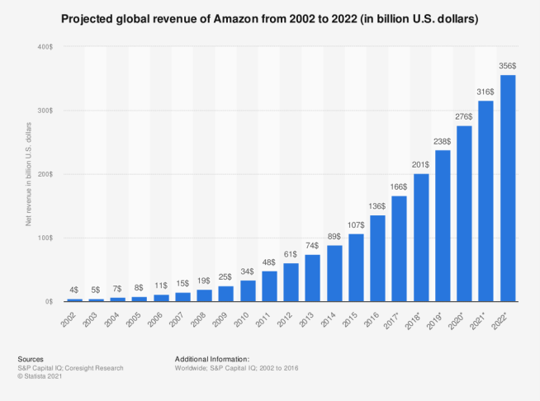
It’s an American multinational technology company with popular products in e-commerce, cloud computing, digital streaming and AI fields. Founded by Jeff Bezos in Washington, back in 1994, today it is one of the big 5 American info-tech companies. Its revenue as of 2021 is around $ 470 Billion.
Its Indian subsidiary, Amazon India has onboarded over 10 lakh sellers & has 22 million prime customers. Worldwide it has 1.468 million employees (2021) and continues to grow with over
2.7 billion visits in Jan 2022. In 5 product categories, amazon holds 90% market share.
Its also a big market price research centre:
66% of Indian urban active users have researched online before buying products.
52% of the online researchers have visited Amazon for their research.
Competitors split: Global Revenue:
Value Proposition:
Low Price
Fast Delivery
A wide selection of
products

Slide 3























Slide 4
The User Flow to Order a Product
Search
Recommendations
Sale / Ads
In-app research / comparisons
Add to Cart
Checkout
Enter Details
Payment Page
Homepage
Product Page
Buy Now
Order Summary
Order Confirmation

Slide 5



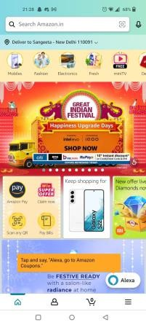
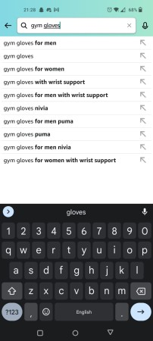
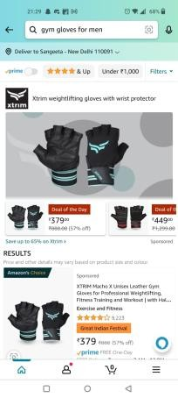
Opens App
Search
Results
Doing
Wow those are some awesome deals. Do they have it on gym gloves?
I like the suggestions. Don’t want wrist support for now. Lets check “gym gloves for men”
These are awesome choices and deals!
Thinking
😲
☺️
😁
Feeling
Pain Points & Solutions

Slide 6

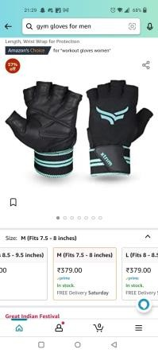
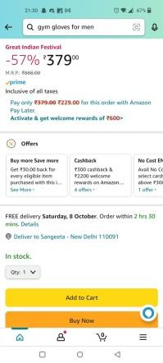
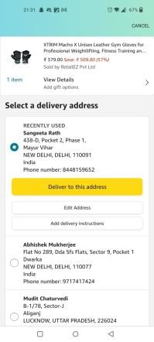
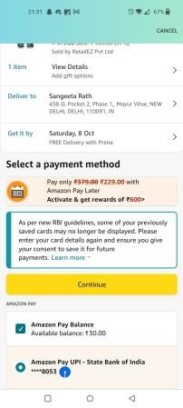
Product Page
Checkout
Enter Details
Doing
I like this blue variant. Why doesn’t this include a size chart description like clothes? I don’t know what to measure now
I think I will be at home on that day. Lets select other details quickly.
Thinking
I have many addresses saved. Have to delete a few of them later.
Feeling
😕
😐
😐
Size Chart not always present.
Inadequate Filters
Need to insert size chart and describe how to measure. Add desired filters to make search experience more precise
Pain Points & Solutions
Forgets to delete old addresses.
Simple periodical reminders

Slide 7
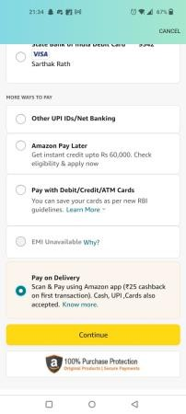
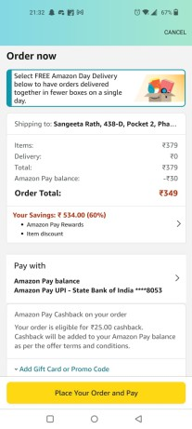
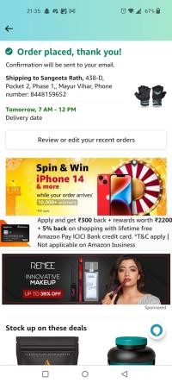
Payment Method
Order detail
confirmation
Done!
Doing
I have some cashback balance from last order’s offers. I like how simple the offers & credit work in this app.
Everything looks good. That was
fast!
Yay! Its going to get delivered tomorrow? Wow! I hope the product turns out great. That was a great deal!
Thinking
☺️
😁
🥳
Feeling
Pain Points & Solutions

Slide 8

The Pros
Voice search, 360 view and AR feature really take UX to another level.
The address and other details selected are automatically recent ones, saves user effort.
UI is intuitive and simple, easier to locate elements due to contrast.
Image search feature is really easy to find and use.
The Cons
Should remind to delete unused addresses.
Although UX is very good, the overall UI looks slightly basic.
Listing page has fewer search filters.
When Amazon pay is used, COD is unavailable. Considering Indian base prefers COD, this should change.

Slide 9
North Star Metric: # Net completed orders.
Conversion Rate
Bounce Rate of all UJ steps to place order
Average order time
Order Cancellation rate
#Orders returned / #Orders completed
DAU / MAU
# Fresh customers
CTR on Search Button
Average order completion time

